Slide 1



2024 CSU Systemwide Business Analytics Competition
Should This Loan be Approved or Denied?
Luyan Zhuang
Pallavi Gowdar Nagaraj
Sindhuja Arivukkarasu
MSBA
MSBA
MSBA

Slide 2






Introduction
Supported small businesses since 1953
Created jobs; reduced unemployment.
Success Stories: Apple, FedEx.
Loan Guarantee Program:
Problem Statement
Loan Defaults: Difficulty in predicting defaults impacts profitability.
Threshold Challenge: Finding the right cut-off to balance risk and profit.

Slide 3

Solution
Develop predictive models to estimate the probability of default.
Determine the optimal classification threshold to guide loan approval decisions, balancing risk and profitability to maximize the bank's net profit.

Slide 4
Data Overview
Size: 899,164 rows and 27 columns.
Target Variable: MIS_Status → Paid in Full (P I F) or Charged Off (CHGOFF).
Predictor Variables: Numerical and categorical features, including:
Loan terms
Business characteristics
Loan performance metrics

Slide 5
Feature Engineering
Monetary Columns: Removed dollar signs and commas; converted to numeric format.
Categorical Columns: Consolidated categories; grouped rare entries under "Other."
NewExist Column: Addressed inconsistencies by creating a new category for 0 and NaN.
Outlier Retention: Preserved outliers to capture real-world variability and maintain data integrity.

Slide 6
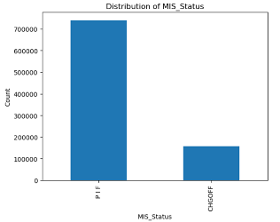
Target Variable: MIS_Status
Paid in Full (PIF): 82.44% of loans successfully repaid.
Charged Off (CHGOFF): 17.56% of loans defaulted.
Missing Values in MIS_Status:
MIS_Status had 0.22% missing values.
Key Patterns:
BalanceGross = 0, ChgOffDate ≠ null: Likely CHGOFF.
BalanceGross = 0, ChgOffDate = null: Likely PIF.
Decision: To avoid bias, dropped rows with missing MIS_Status.

Slide 7
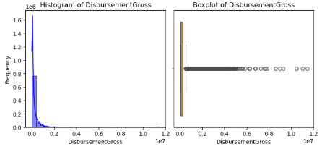
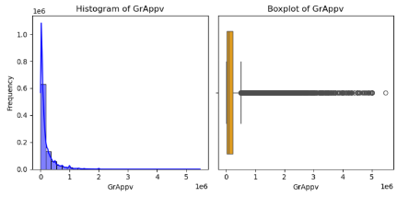
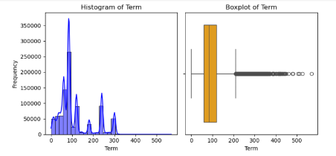
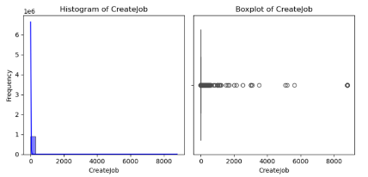
Univariate Analysis: Numerical Features

Slide 8
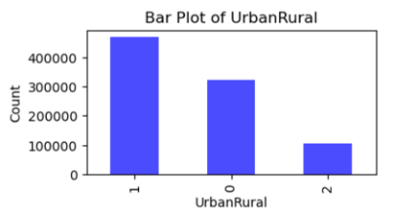
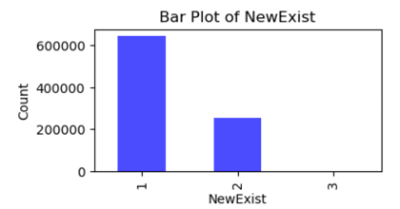
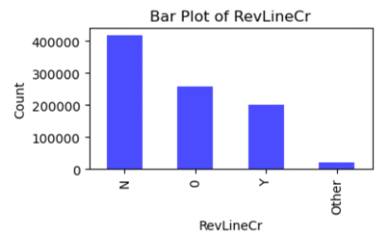
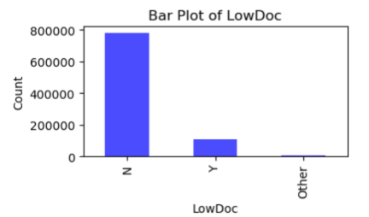
Univariate Analysis: Categorical Features
Notes:
UrbanRural:
• The majority of loans were granted to urban areas (1), followed by undefined areas (0) and rural areas (2).
• This suggests a strong preference for lending in urban settings, possibly due to better access to businesses and financial infrastructure.
NewExist:
• Most loans were issued to existing businesses (1), while a smaller proportion went to new businesses (2).
• Very few loans were categorized as undefined (3), indicating clear documentation for most loans.

Slide 9
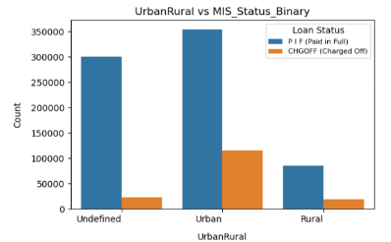
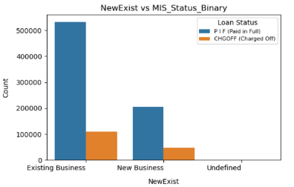
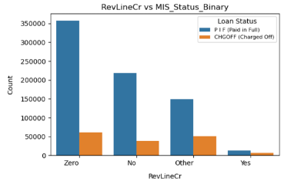
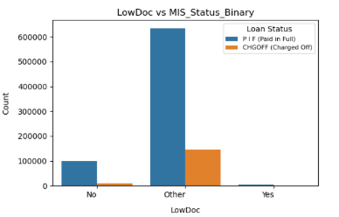
Bivariate Analysis: Categorical Features
Notes:
Insights:
• Urban areas and existing businesses dominate the loan distribution, with a higher likelihood of loans being paid in full.
• New businesses and loans with revolving credit show a slightly higher risk of default.
• Low documentation loans exhibit a higher tendency for defaults compared to loans with complete documentation.

Slide 10
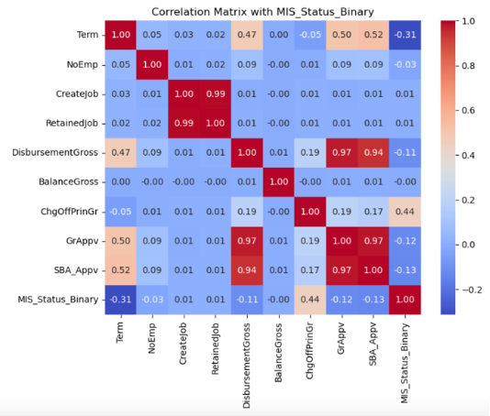
Correlation Matrix for Numeric Features

Slide 11

Machine Learning Models
kNN
Classification Trees: Single tree, bagging, boosting, random forest
Logit Models: Lasso, Ridge, ElasticNet
Neural Networks
Discriminant Analysis

Slide 12
Model Development Steps
Normalize Predictors: Standardize numerical features to ensure uniform scaling.
Hyperparameter Tuning: Use cross-validation to optimize model parameters.
Determine Threshold: Select the best cut-off probability for classification.
Evaluate Metrics: Assess model performance using metrics like accuracy, sensitivity, and specificity.
Profit Calculation: Calculate net profit based on the cost-gain matrix.

Slide 13
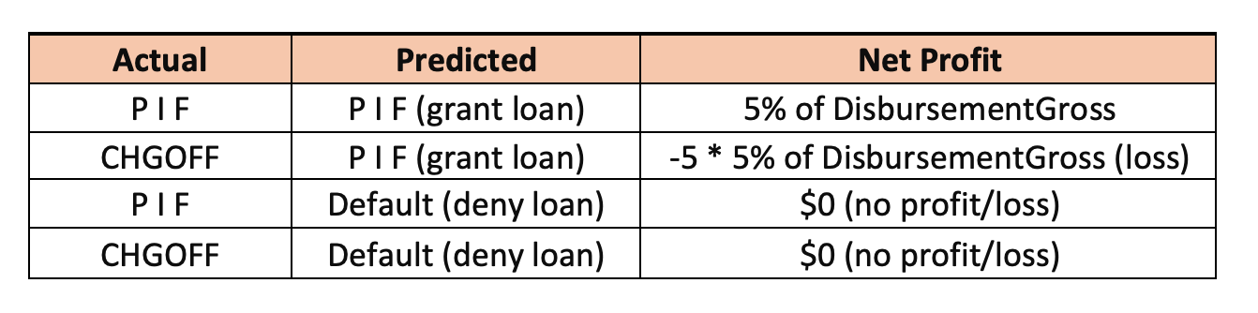
Cost-Gain Matrix
Threshold Determination: The optimal threshold was selected by maximizing the F1-Score using the Precision-Recall Curve.

Slide 14
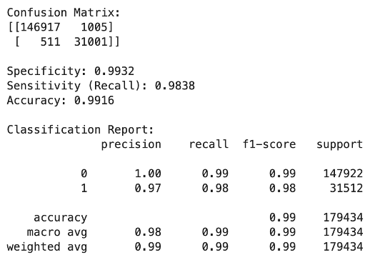
KNN - K-Nearest Neighbors
Hyperparameter Tuning: Explored n_neighbors (3–21) and metrics (Euclidean, Manhattan, Minkowski).
Best Parameters: {metric: 'euclidean', n_neighbors: 5}.
Optimal threshold: 0.4.
Total Net Profit: $1.586 billion.

Slide 15
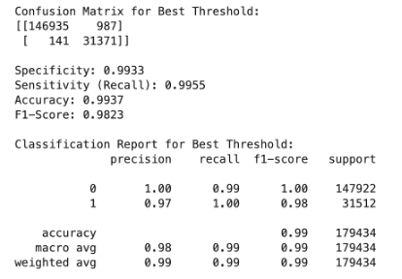
Classification Trees: Random Forest
Best Parameters:
{bootstrap: True, max_depth: None, max_features: 'sqrt', min_samples_leaf: 5, min_samples_split: 2, n_estimators: 100}
Optimal Threshold: 0.4704
Total Net Profit: $1,589,844,341.60

Slide 16
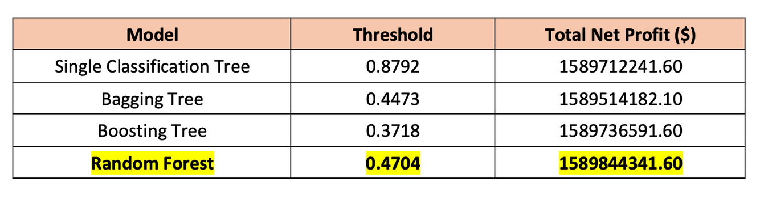
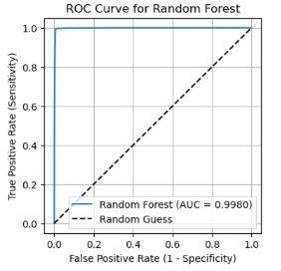
Comparison of Classification Trees Models
Random Forest outperformed others with the highest profit while maintaining robust metrics.

Slide 17
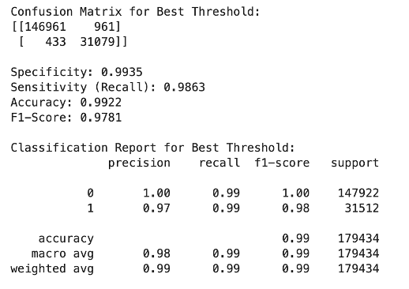
Logit: Base Logistic Regression
Solver: lbfgs
Efficient for small-to-medium datasets.
Optimizes log-likelihood loss using quasi-Newton methods.
Does not require a learning rate parameter, unlike SGD.
Optimal Threshold: 0.3708
Total Net Profit: $1,579,861,133.90

Slide 18
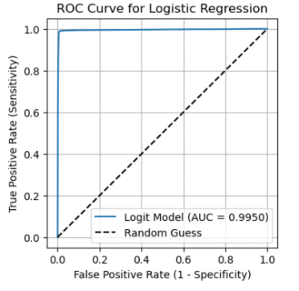
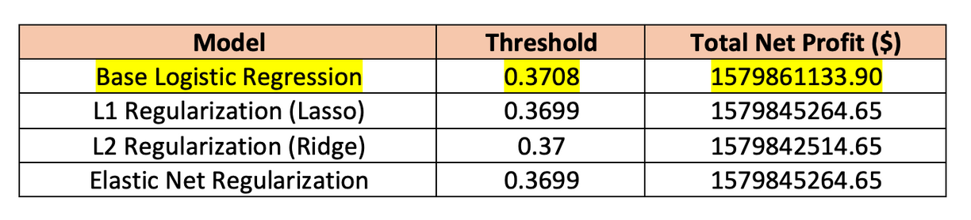
Comparison of Logit Models
Base Logistic Regression is the best choice for simplicity and highest profit

Slide 19
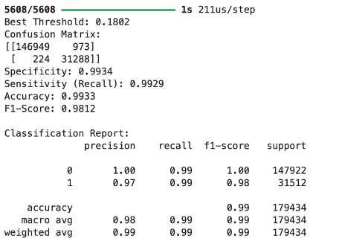
Neural Networks
Architecture: 3 hidden layers (128, 64, 32 neurons).
Activation: ReLU for hidden layers, Sigmoid for output.
Optimizer: Adam with learning rate of 0.001.
Early Stopping: 5 epochs patience, max 50
Optimal Threshold: 0.1802.
Total Net Profit: $1,586,310,134.45.

Slide 20
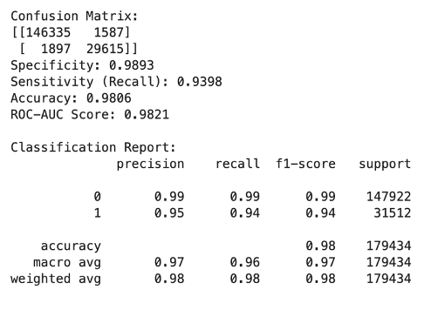
Discriminant Analysis
Combines LDA and QDA using a regularization parameter (reg_param).
Hyperparameter Tuning:
Explored reg_param values [0.0, 0.1, 0.2, ..., 1.0].
Best Parameter: reg_param = 0.0 (model behaved as LDA).
Optimal Threshold: 0.2404.
Total Net Profit: $1,558,540,857.85.

Slide 21
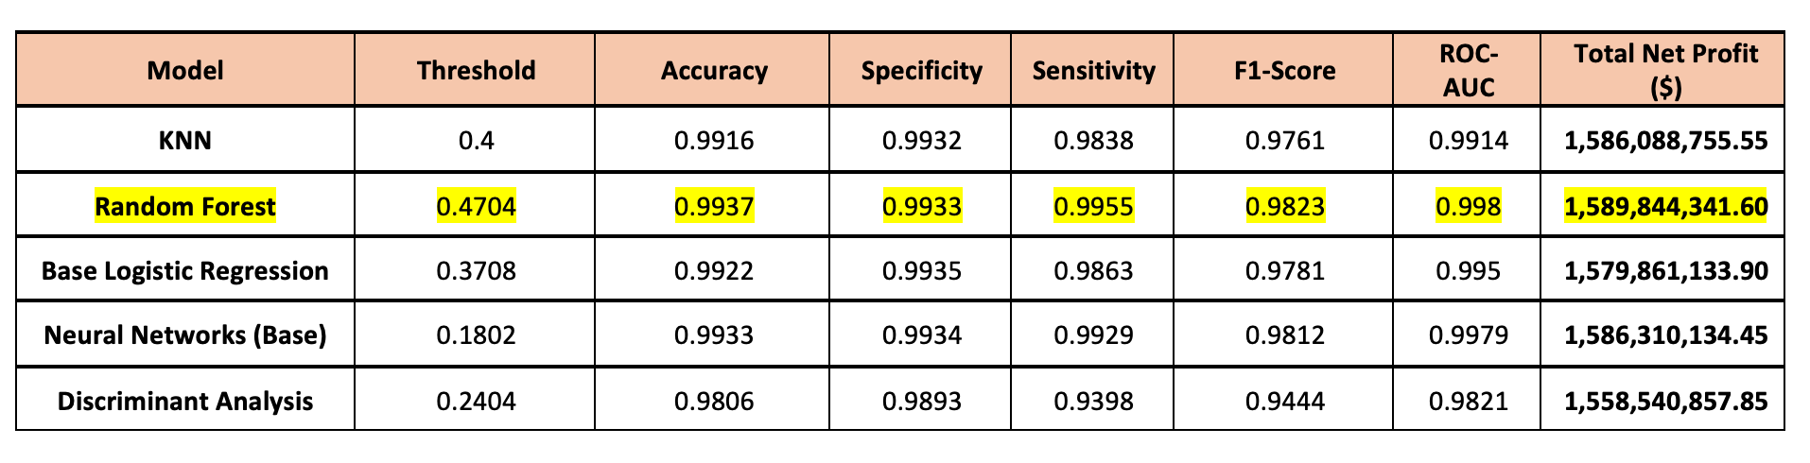
Models Comparison
Random Forest is the recommended model
Maximizes profit ($1,589,844,341.60).
Achieves high sensitivity (0.9955) and predictive accuracy (0.9937).
Notes:
Model Comparison:
Now that we’ve reviewed the individual models in detail, let’s compare their performance side by side to finalize our recommendation."
We’ve compared key metrics:accuracy, specificity, sensitivity, F1-Score, ROC-AUC, and most importantly, total net profit in dollars.
Based on this comparison, Random Forest is our recommended model.
It balances all the key metrics—profit, sensitivity, and accuracy—making it the most robust choice for the business objective.
Its ability to correctly predict defaults ensures the loan approval process is both profitable and risk-mitigating.

Slide 22
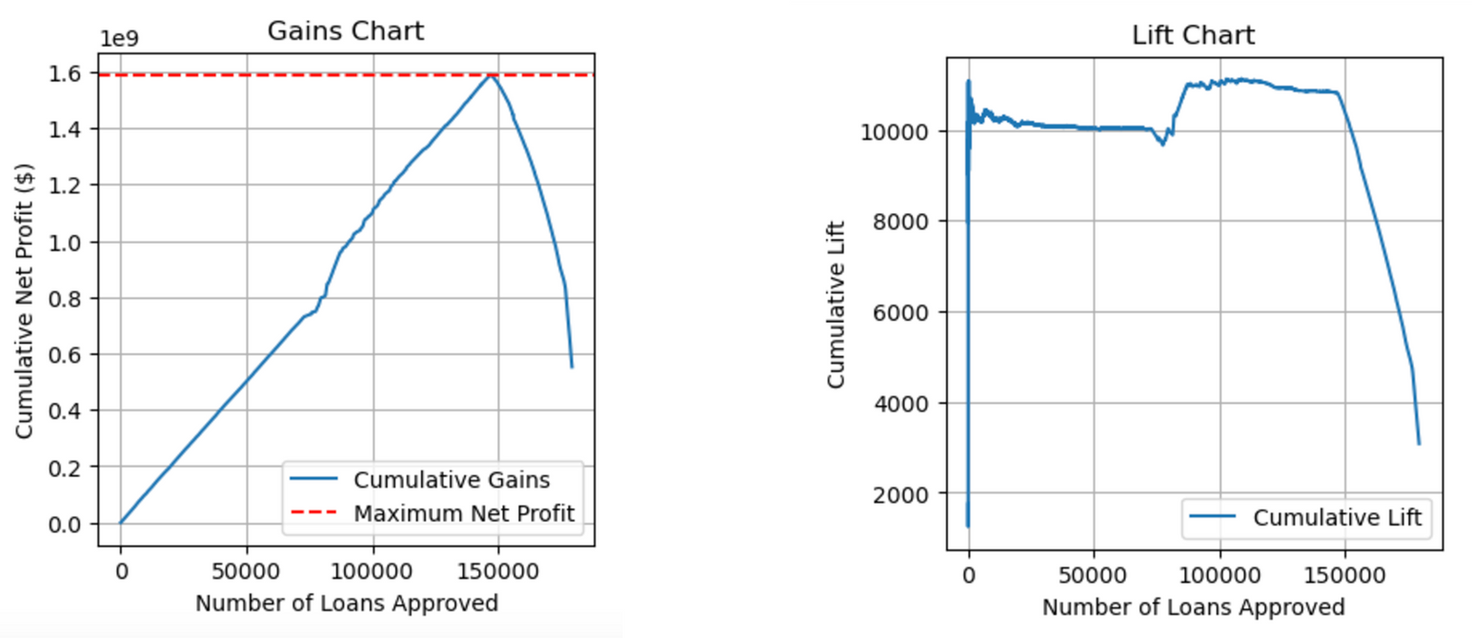
Profit Optimization by Random Forest
Maximum Net Profit: $1,589,851,091.60.
Loans Approved: 147,072.
Optimal Probability Threshold: 0.3804.

Slide 23
Final Recommendation
Approval Strategy:
Approve loans in order of predicted probabilities, starting with least risky applicants.
Stop approvals after 147,072 loans to maximize profit.
Future Loan Scoring:
Use a probability threshold of 0.3804 for granting future loans.

Slide 24

Thank you!

